Slide 1






Data Exploration & Wrangling
ANKIT MIRAJKAR

Slide 2

DATA EXPLORATION
Exploratory Data Analysis (EDA), also known as Data Exploration, is a step in the Data Analysis Process, where a number of techniques are used to better understand the dataset being used.
‘Understanding the dataset’ can refer to a number of things including but not limited to…
Extracting important variables and leaving behind useless variables
Identifying outliers, missing values, or human error
Understanding the relationship(s), or lack of, between variables
Ultimately, maximizing your insights of a dataset and minimizing potential error that may occur later in the process
Why EDA?
Helps you prepare your dataset for analysis.
Allows a machine learning model to predict our dataset better.
Gives you more accurate results.
It also helps us to choose a better machine learning model.

Slide 3
1. Understand the Problem and the Data
Clearly define the analysis goal, research the domain, and familiarize yourself with available datasets, their context, and relevant features
2. Import and Inspect the Data
Review its structure (rows, columns, types), examine variable names, and perform a quick scan
3. Data Cleaning (Handle Missing Values and Errors)
4. Data Transformation
5. Data Exploration
6. Data Visualization
7. Handling Outliers
8. Data Summarization and Reporting
Identify and address missing values, remove duplicates, correct data types, and resolve inconsistencies or errors.
Normalize or standardize data, encode categorical variables if needed, perform feature engineering, and aggregate or disaggregate as required for subsequent analysis
Use univariate, bivariate, and multivariate analyses to study the distribution and relationships between features.
Create visual representations―histograms, box plots, scatter plots, heatmaps, bar charts, etc.
Detect and assess outliers using statistical methods
Document the process and main findings, summarize the results with clear descriptive statistics and visualizations

Slide 4
STEPS INVOLVED IN DATA EXPLORATION
Components of EDA
There are main components of exploring data:
Understanding your variables
Cleaning your dataset
Analyzing relationships between variables
Some methods:
.shape returns the number of rows by the number of columns for my dataset.
.head() returns the first 5 rows of my dataset
.columns returns the name of all of your columns in the dataset.
.describe() summarizes the count, mean, standard deviation, min, and max for numeric variables
.unique(), gives me discrete variables
Removing Redundant variables
Variable Selection
Removing Outliers
Correlation Matrix
Scatterplot
Histogram
Boxplot

Slide 5
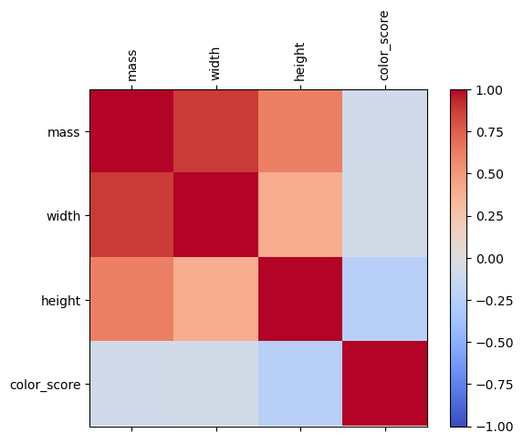
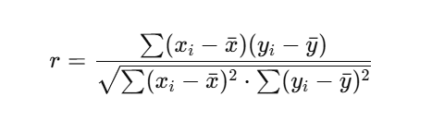
Correlation
“Correlation” refers to statistical measures that quantify the strength and direction of the relationship between two numeric variables
Pearson’s correlation coefficient (r) is the most common type—it measures linear relationships
It ranges from –1 (perfect negative) to +1 (perfect positive), with 0 indicating no linear relationship.

Slide 6

DATA WRANGLING
Data Wrangling is the process of collecting and modifying the raw data into another form for analyzing and decision- making easily. It is also known as Data Munging
Data Wrangling Operations in Python
Handling missing or null values
Grouping Data
Reshaping the data
Filtering the data

Slide 7
1.Deleting Rows with missing values
HANDLING MISSING VALUES
Impute missing values for continuous variable
Impute missing values for categorical variable
Other Imputation Methods
Using Algorithms that support missing values
Prediction of missing values

Slide 8
Missing values can be handled by deleting the rows or columns having null values.
DELETE ROWS WITH MISSING VALUES
The rows which are having one or more columns values as null can also be dropped.
Pros:
A model trained with the removal of all missing values creates a robust model.
Cons:
Loss of a lot of information.
Works poorly if the percentage of missing values is excessive in comparison to the complete dataset.

Slide 9
IMPUTE MISSING VALUES WITH MEAN/MEDIAN
Columns in the dataset which are having numeric continuous values can be replaced with the mean, median, or
mode of remaining values in the column. This method can prevent the loss of data compared to the earlier method.
Pros:
Prevent data loss which results in deletion of rows or columns
Works well with a small dataset and is easy to implement.
Cons:
Works only with numerical continuous variables.
Can cause data leakage
Do not factor the covariance between features.

Slide 10
IMPUTATION METHOD FOR CATEGORICAL COLUMNS
When missing values is from categorical columns (string or numerical) then the missing values can be replaced with the most frequent category.
Pros:
Prevent data loss which results in deletion of rows or columns
Works well with a small dataset and is easy to implement.
Negates the loss of data by adding a unique category
Cons:
Works only with categorical variables.
Addition of new features to the model while encoding, which may result in poor performance

Slide 11
Depending on the nature of the data or data type, some other imputation methods may be more
appropriate to impute missing values.
OTHER IMPUTATION METHODS
For example, for the data variable having longitudinal behavior, it might make sense to use the last valid observation to fill the missing value. This is known as the Last observation carried forward (LOCF) method.
For the time-series dataset variable, it makes sense to use the interpolation of the variable before and
after a timestamp for a missing value.

Slide 12
All the machine learning algorithms don’t support missing values, but some ML algorithms are robust to missing values in the dataset. The k-NN algorithm can ignore a column from a distance measure when a value is missing. Naive Bayes can also support missing values when making a prediction. These
algorithms can be used when the dataset contains null or missing values.
USING ALGORITHMS THAT SUPPORT MISSING VALUES:
Another algorithm that can be used here is RandomForest that works well on non-linear and categorical data. It adapts to the data structure taking into consideration the high variance or the bias, producing
better results on large datasets.
Pros:
No need to handle missing values in each column as ML algorithms will handle them efficiently.
Cons:
No implementation of these ML algorithms in the scikit-learn library.

Slide 13
In the earlier methods to handle missing values, we do not use the correlation advantage of the variable containing the missing value and other variables. Using the other features which don’t have nulls can be used to predict missing values.
PREDICTION OF MISSING VALUES:
The regression or classification model can be used for the prediction of missing values depending on the nature (categorical or continuous) of the feature having missing value.
Pros:
Gives a better result than earlier methods
Considers the covariance between the missing value column and other columns.
Cons:
Considered only as a proxy for the true values

Slide 14
DETECT AND REMOVE THE OUTLIERS
When exploring data, the outliers are the extreme values within the dataset. That means the outlier data points vary greatly from the expected values—either being much larger or significantly smaller.
Find outliers in your dataset
Use data visualization techniques to inspect the data’s distribution and verify the presence of outliers:
Histogram
Box plot
Scatter plot
Use a statistical method to calculate the outlier data points.
Apply a statistical method to drop or transform the outliers:
Drop the outliers
Cap the outliers
Replace outliers using imputation as if they were missing values

Slide 15
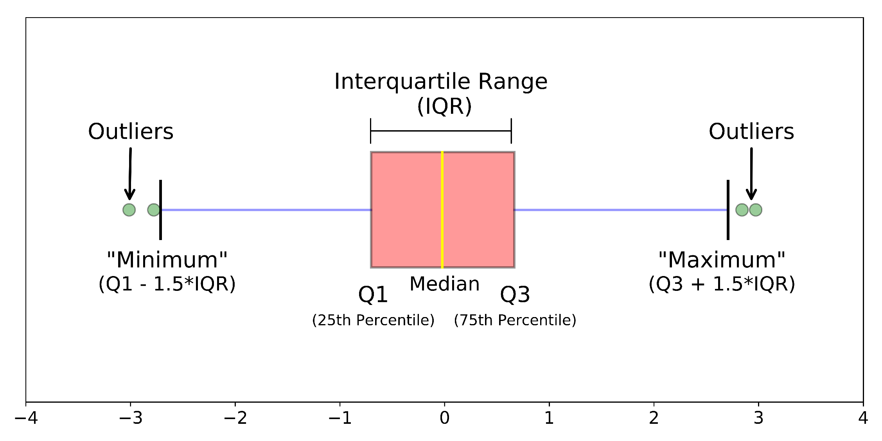
Box plot for outlier detection and removal

Slide 16
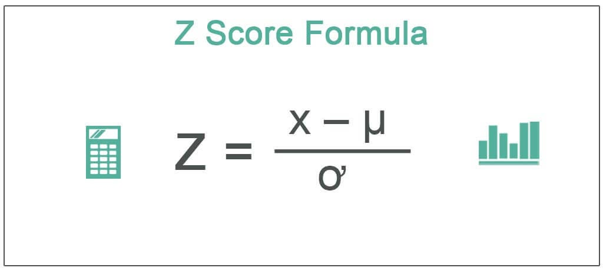
Z SCORE FOR OUTLIER DETECTION:
Z score is an important concept in statistics. Z score is also called standard score.
This score helps to understand if a data value is greater or smaller than mean and how far away it is from the mean.
Here’s what each component means:
Z is the Z-score we’re calculating.
X is the specific data point we want to evaluate.
μ (mu) is the mean (average) of the dataset.
σ (sigma) is the standard deviation, which measures how spread out the data is.
Z-Score Greater than 3 (or Less than -3): Using a threshold of Z-scores greater than 3 or less than -3 is a stricter criterion for identifying outliers. Data points that exceed this threshold are considered highly unusual and are typically reserved for identifying extreme outliers.

